Slide 1


GitHub Copilot Dev Days
Adrien CLERBOIS
AI Charlatan @ Sense of Tech
Notes:
Welcome everyone to GitHub Copilot Dev Days. My name is Adrien Clerbois, and I’m so excited to be here this is just one of hundreds of global events that GitHub and the development community partnered with to show off the latest and greatest and agentic development with GitHub Copilot.

Slide 2

GitHub Agentic Workflows
TECHNICAL PREVIEW
ADRIEN CLERBOIS
AI Charlatan
Sense of Tech
Notes:
Hello and welcome to this session on GitHub Agentic Workflows!

Slide 3


TECHNICAL PREVIEW
De l'automatisation à l'intelligence
GitHub Agentic Workflows
Demo
Q&A
Notes:
Au cours des 30 prochaines minutes, je souhaite :
Commencer par vous présenter l'évolution de l'automatisation et vous expliquer comment nous en sommes arrivés là.
Ensuite, je vous présenterai les workflows GitHub Agentic : ce qu'ils sont et comment ils peuvent réellement vous aider.
Puis, je ferai une démonstration pour vous montrer :
- Comment configurer un workflow de manière agentique en interrogeant un agent (pour un workflow de triage des tickets).
- Comment exécuter à grande échelle à partir d’un référentiel centralisé (pour le déploiement intelligent de la configuration de Dependabot à l’échelle de l’organisation).
Nous terminerons par une séance de questions-réponses : vous pourrez alors poser toutes vos questions, mais n’hésitez pas à venir me voir après la session.
Avant de nous plonger dans ce que nous avons construit, prenons un peu de recul pour voir comment nous en sommes arrivés là et pourquoi…

Slide 4
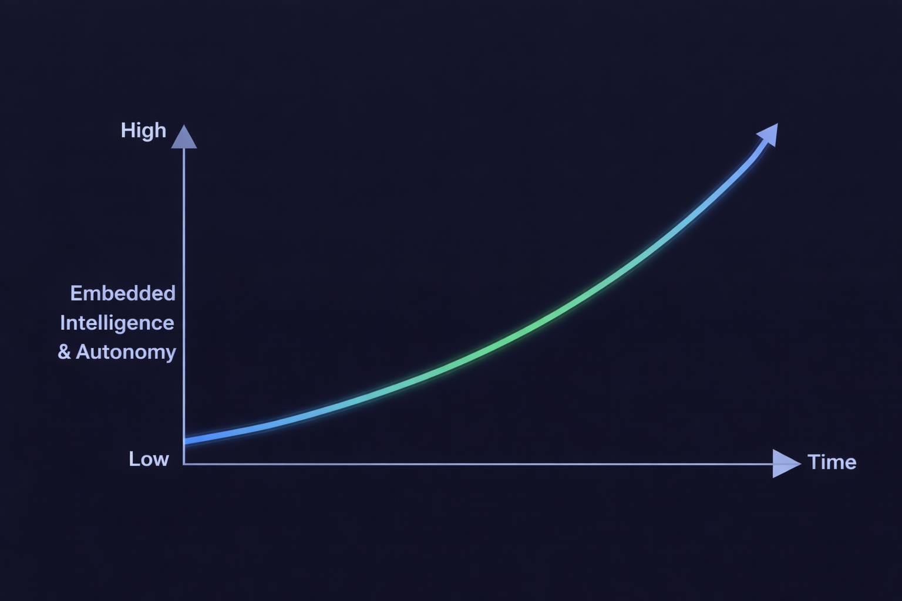


TECHNICAL PREVIEW
De l'automatisation à l'intelligence
Intégrer l'intelligence dans des processus fiables :
L'automatisation est la base 2018: Launch of GitHub Actions
Copilot vous aide dans l'éditeur 2021: Launch of GitHub Copilot
Software Engineering (SWE) agents exécutent des tâches 2025: Launch of GitHub Copilot Coding Agent
Flux de travail autonomes dotés d'une intelligence intégrée 2026: Launch of GitHub Agentic Workflows
GitHub Agentic Workflows
EMBEDDED INTELLIGENCE
GitHub Copilot Coding Agent
GitHub Copilot
GitHub Actions
2018
TIME
2026
Notes:
Over the last decade, we have evolved CI/CD and optimized software delivery for reliability and speed.
Now we are starting a new journey! The graph (on RHS) shows how intelligence is being embedded into the software delivery system. What changes over time isn’t automation — it’s how much reasoning the system can do inside the workflow.
Looking at the GitHub Platform features, we can see how this evolved over time:
Automation is the foundation:
In 2019, GitHub Actions brought workflows directly into the platform: event-driven, versioned with code, explicitly triggered, and fully auditable. Execution was deterministic. The system runs pre-defined logic: no interpretation, no reasoning. Just state transitions. This model established trust and it continues to govern CI/CD today.
Copilot assists in the editor:
In 2021, GitHub Copilot introduced context-aware code completion. Repository context, human-in-the-loop review, etc. The model assists, the developer remains in control. Reasoning is introduced at the point of creation, but execution in our workflows remains deterministic.
Coding agent acts on tasks:
In 2025, the SWE (Software Engineering) agent awakened. Reasoning expanded from tokens to tasks. Multi-file context, goal-driven interaction, repository awareness. The system can decompose intent but still operates within explicit boundaries.
Agentic workflows run with intelligence built-in:
Agents operate inside CI. Actions trigger validation. guardrails constrain scope. All changes are observable and auditable. Deterministic systems provide enforcement, while intelligent systems provide adaptation. We’re not replacing deterministic systems; we’re layering probabilistic reasoning on top of them.
GitHub Agentic Workflows makes this possible. Let’s dive into what they are in more detail…

Slide 5
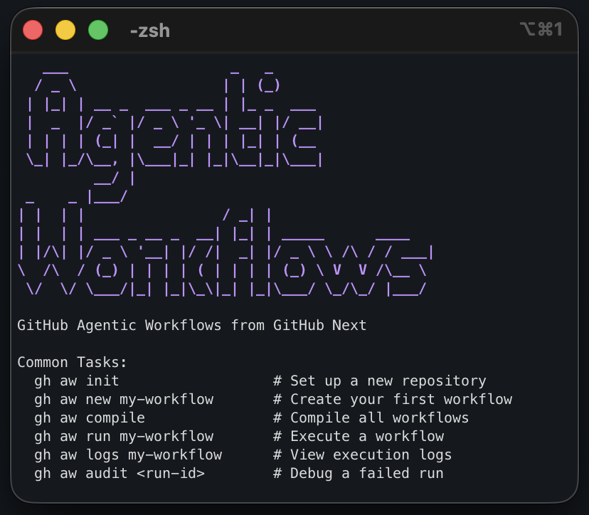
TECHNICAL PREVIEW
GitHub Agentic Workflows
Combinez en toute sécurité GitHub Actions et les agents SWE à l'aide de notre interface de ligne de commande (CLI).
Prérequis:
Compte IA - Utilise GitHub Copilot par défaut
GitHub Repository - Un repository auquel vous avez un accès en écriture
GitHub Actions active
GitHub CLI (gh) v2.0.0+
OS : Linux, macOS, or Windows avec WSL
Installation: Installer le CLI GitHub Agentic Workflows gh extension install github/gh-aw
Notes:
GitHub Agentic Workflows brings AI-powered software engineering agents into GitHub Actions. Instead of introducing a separate automation system, this approach extends the CI/CD platform teams already use and trust.
The GitHub Agentic Workflows CLI acts as the control surface for setting up and managing agentic workflows. The CLI provides a guided setup experience: Standardized installation and upgrade process, reduced configuration errors, built-in validation checks, simplified workflow management through gh aw command.
Prerequisites: Before installing, a few requirements must be in place.
AI Account: An AI provider is required to power the agent’s reasoning and generation capabilities. By default, this setup assumes GitHub Copilot. The agent enables intelligent automation inside workflows.
GitHub Repository : You must have write access to a repository.
GitHub Actions Enabled: Actions must be enabled in repository settings.
GitHub CLI (gh) v2.0.0+: Agentic Workflows installs as a GitHub CLI extension, so the CLI must already be installed. Verify version with gh –version. Requires version 2.0.0 or later. Serves as the management interface for workflows.
Supported Operating System A shell-based environment is required to run CLI commands: Linux, macOS, Windows with WSL.
Setup: Install the GitHub Agentic Workflows CLI
It is an extension for the GitHub CLI, so we install it with: gh extension install github/gh-aw
Getting started:
This is your management console for all agentic workflow related things! The screenshot (on RHS) show some of the useful commands we have available to us (gh aw…). To add Agentic Workflows capabilities to a repo, navigate it and just run: gh aw init. You can also compile/run/audit workflow as well as add workflow from our agentics collection (gh aw add or add-wizard)
Let’s find out more what an agentic workflow (source/file) looks like…

Slide 6
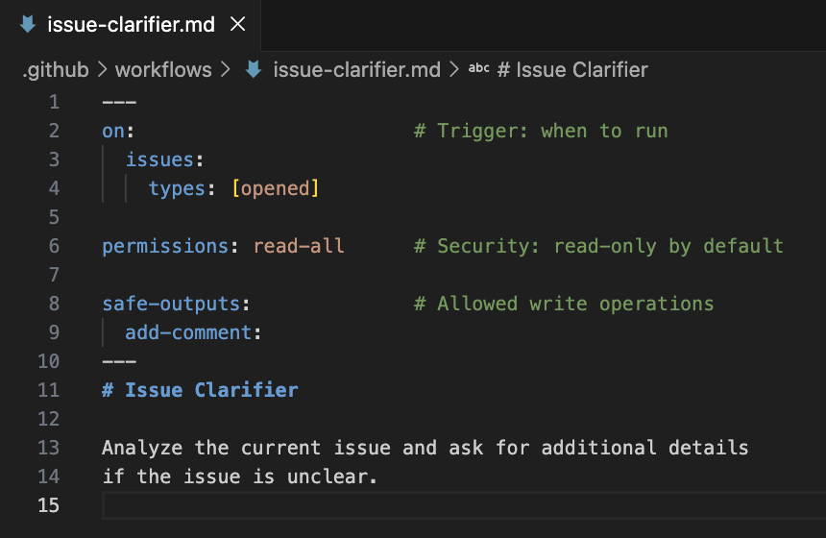
TECHNICAL PREVIEW
GitHub Agentic Workflows
Utilisez les frontmatter pour définir quand un workflow s'exécute et quelles données il est autorisé à lire et à écrire.
Obligatoire : Trigger configuration: on
Optionnelle :
AI configuration: engine
Execution: jobs, concurrency, if
Capabilities: tools, imports, env
Metadata: name, description, label, source
Security & Access: permissions, network, safe-outputs
Runtime: runs-on, timeout-minutes, environment
Consultez la documentation pour obtenir une référence complète sur
le frontmatter.
Notes:
GitHub Agentic workflow sources are markdown files.
At the top of the file, we define the frontmatter: the configuration block that defines when the workflow runs, what it can access and what it can modify.
The only required field is on, which (just like Action yaml) specifies the trigger event, such as when an issue is opened or a pull request is created.
Everything else is optional and grouped into categories:
AI configuration like engine, which selects the AI engine to use.
Execution controls like jobs, if, and concurrency, which control how the workflow runs.
Capabilities like tools, imports, and env, which define what the workflow can use.
Security settings like permissions, safe-outputs, and network, which limit what the workflow can read or write.
Runtime settings like runs-on and timeout-minutes, which define where and how long it runs.
In short, frontmatter makes workflows secure, controlled, and predictable by explicitly defining their behavior and access boundaries. This is not an exhaustive list, for more, please visit our full frontmatter reference, a great look up (for future reference) to see all possible choices at a glance!
Let’s look at an example (on RHS) for an “Issue Clarifier” agentic workflow:
We can see the frontmatter at the top of the file, defining that this workflows will run on opened issues, is read-only by default (agent) and will safely write by adding a comment to the issue.
But what about defining the agent instructions?

Slide 7
TECHNICAL PREVIEW
GitHub Agentic Workflows
Écrivez du code Markdown simple pour définir vos besoins en matière d'automatisation :
Rédigez les instructions en langage naturel. Markdown file *.md
Compiler pour valider et générer un workflow exécutable. Yaml file *.lock.yml
gh aw compile
MD
YML
Notes:
Most agent interfaces we know have text input as prompts, so it feels only natural that we have the same here. Hence, the rest if the file contains plain markdown, where we declare the AI agent out automation needs as natural language instructions.\
The ”Issue Clarifier” workflow (on RHS) shows how easy it is. We simply instructed the agent to analyze the current issue and clarify anything that is unclear.
To be executable, we need to compile this markdown with our GitHub Agentic Workflows CLI: gh aw compile Our source markdown file then gets transformed in a regular GitHub Actions yaml with our deterministic compiler and it is thus executable just like any other GitHub Action.
So now we have the intelligence (agent step) in place and brought into the CI/CD, what capabilities did we unlock that we did not have before?

Slide 8
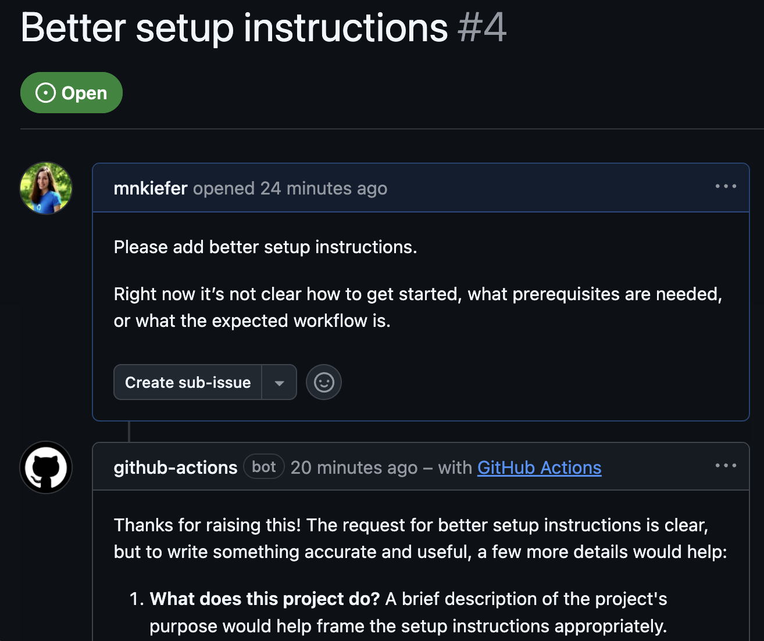




TECHNICAL PREVIEW
GitHub Agentic Workflows
Grâce à Agentic Workflows, votre CI/CD peut : Understand context
Consulter le repository, issues & pull requests, etc.
Prendre des décisions Choisissez la marche à suivre en fonction du contexte, et pas seulement en fonction de conditions prédéfinies
Gardez le cap Comprendre les concepts, et pas seulement les fonctionnalités de base de GitHub.
Moteurs d'IA pris en charge :
Notes:
With agentic workflows, we bring intelligence into CI/CD:
Instead of just reacting to predefined triggers, the workflow can understand context. It can read the repository, issues, pull requests, and related discussions to understand what is happening.
It can then make decisions based on that context, not just simple “if this, then that” conditions. It evaluates the situation and chooses the appropriate action.
It also stays on course by understanding the bigger concepts, not just GitHub events and it reasons about intent, impact, and completeness.
In short, we’ve made CI/CD become context-aware and decision-capable, rather than purely rule-driven.
But we’ve done it safely too…

Slide 9
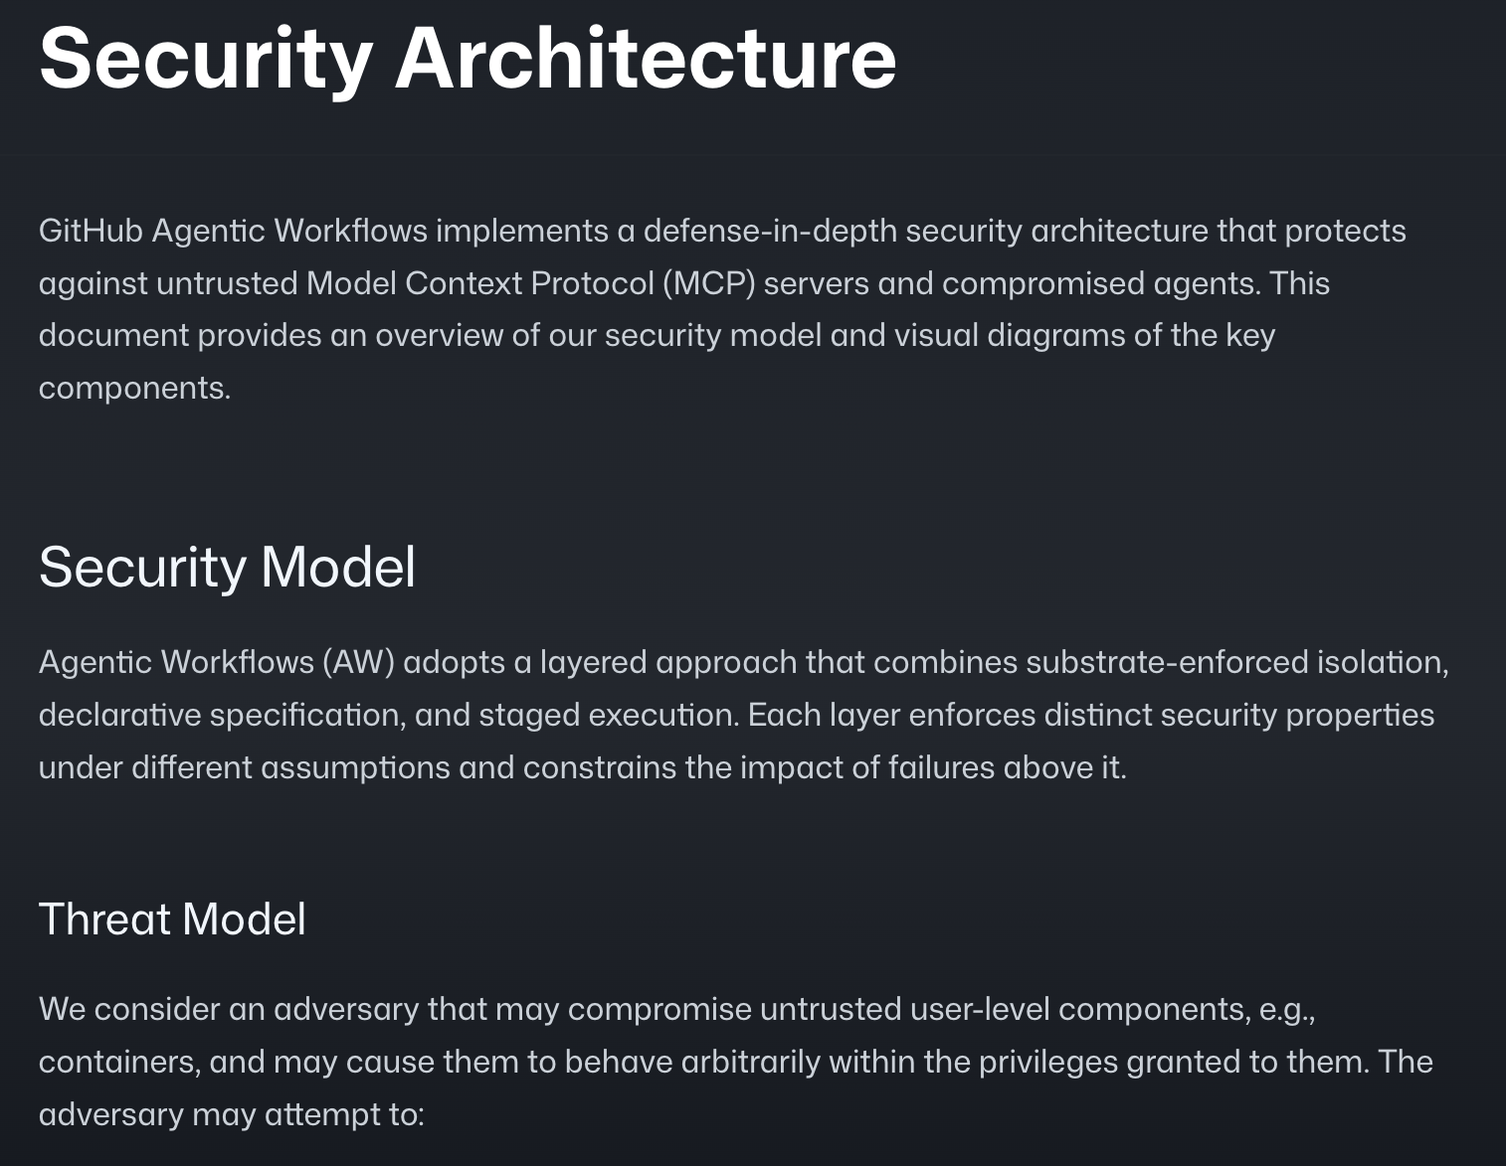
TECHNICAL PREVIEW
GitHub Agentic Workflows
Les workflows Agentic accordent la priorité à la sécurité :
agent Dispose de droits en lecture seule et se contente de proposer des actions.
detection Les analyses de détection des menaces examinent les données générées par l'agent afin d'identifier d'éventuels problèmes de sécurité.
safe outputs Exécutez les actions proposées dans des conteneurs isolés.
Pour en savoir plus, consultez notre présentation de l'architecture de sécurité.
Notes:
Agentic workflows have been built with security as a priority (from day 1):
The agent runs with read-only permissions and does not directly make changes. Instead, it proposes actions based on what it understands.
Before anything happens, a threat detection analysis scans the agent’s output for potential security issues. This ensures the agent’s suggestions are safe before they are executed.
Proposed actions are then executed only in isolated containers using the safe outputs mechanism. This means that even if something goes wrong, it cannot affect the rest of the system.
In short, the workflow separates understanding, detection, and execution so that intelligence is safe and controlled.
For more details, you can read about the full security architecture in our reference documentation.
So now you know what an agentic workflow is, what it enables us to do. But we don’t just want to share the technology itself but also some learnings that we’ve derived from it and common patterns that we discovered by dog-fooding on ourselves excessively (really pushing the boundaries) and from working with design partners along the way…

Slide 10
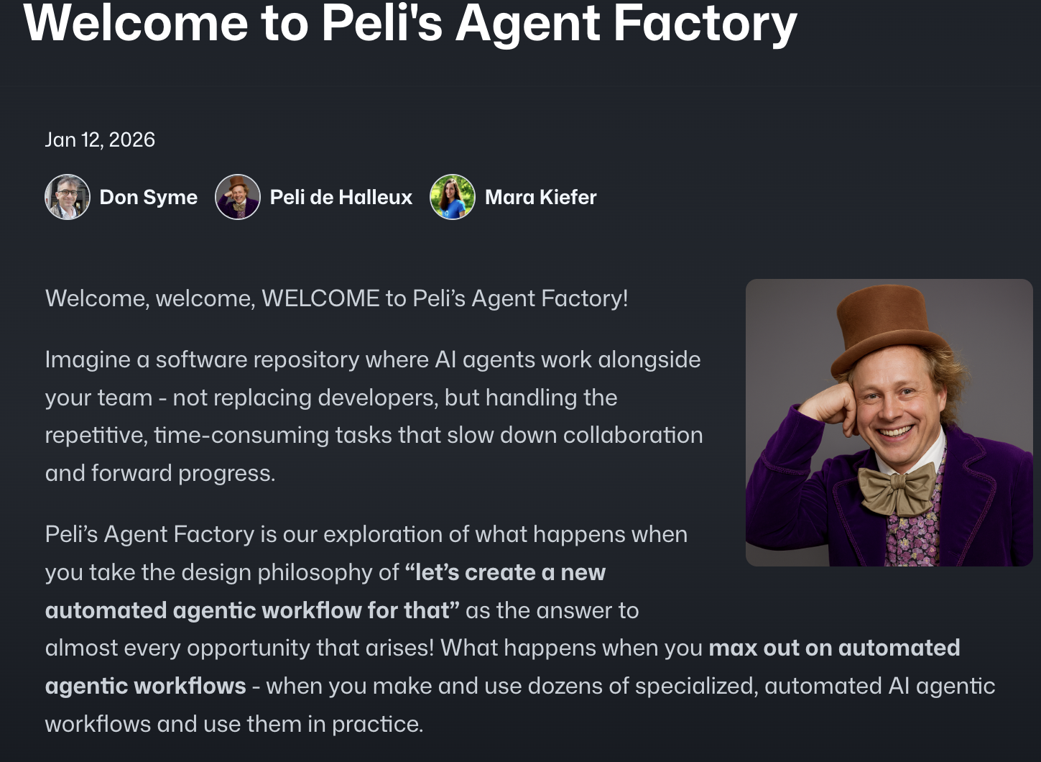
TECHNICAL PREVIEW
GitHub Agentic Workflows
Agentic Workflows constituent les éléments fondamentaux de l'IA continue
Reactive Intelligence (ChatOps · IssueOps) L'IA traite les problèmes, les demandes de modification et les
commentaires afin de les classer par priorité, etc.
Continuous Improvement (DailyOps · TaskOps) Analyses programmées basées sur l'IA et mises à jour progressives.
Insight & Governance (DataOps · ProjectOps) Analyser les données du référentiel et mettre à jour automatiquement l'état du projet.
Orchestration (MultiRepoOps · CentralRepoOps) Coordonner le travail entre les référentiels grâce à une supervision centralisée.
Et bien d'autres encore ! Découvrez nos « modèles de conception ».
Peli’s Agent Factory
Notes:
All of this led us to a series of design patterns which we’ve observed repeatedly so we documented them for you!
Seeing this evolve, we believe that Agentic Workflows are the building blocks of Continuous AI. The key shift is that AI is no longer used on demand as a one-off assistant — it operates continuously inside your software lifecycle. Instead of waiting for someone to manually trigger it, Continuous AI reacts in real time to issues, pull requests, and comments to triage, clarify, and guide discussions. It doesn’t just execute predefined rules; it understands context and makes informed decisions.
It also drives continuous improvement by running on schedules — analyzing code, identifying risks, suggesting enhancements, and applying incremental upgrades automatically. Beyond reactive and scheduled tasks, it provides insight and governance. It can analyze repository and project data, detect trends, surface risks, and automatically update project state to keep teams aligned.
At scale, it enables orchestration across multiple repositories with centralized oversight, coordinating work across systems rather than operating in isolation.
In short, Agentic Workflows are the execution layer, and Continuous AI is the broader vision: intelligent systems embedded directly into CI/CD — always observing, reasoning, and improving, not just responding when prompted.
Excited to get started?

Slide 11
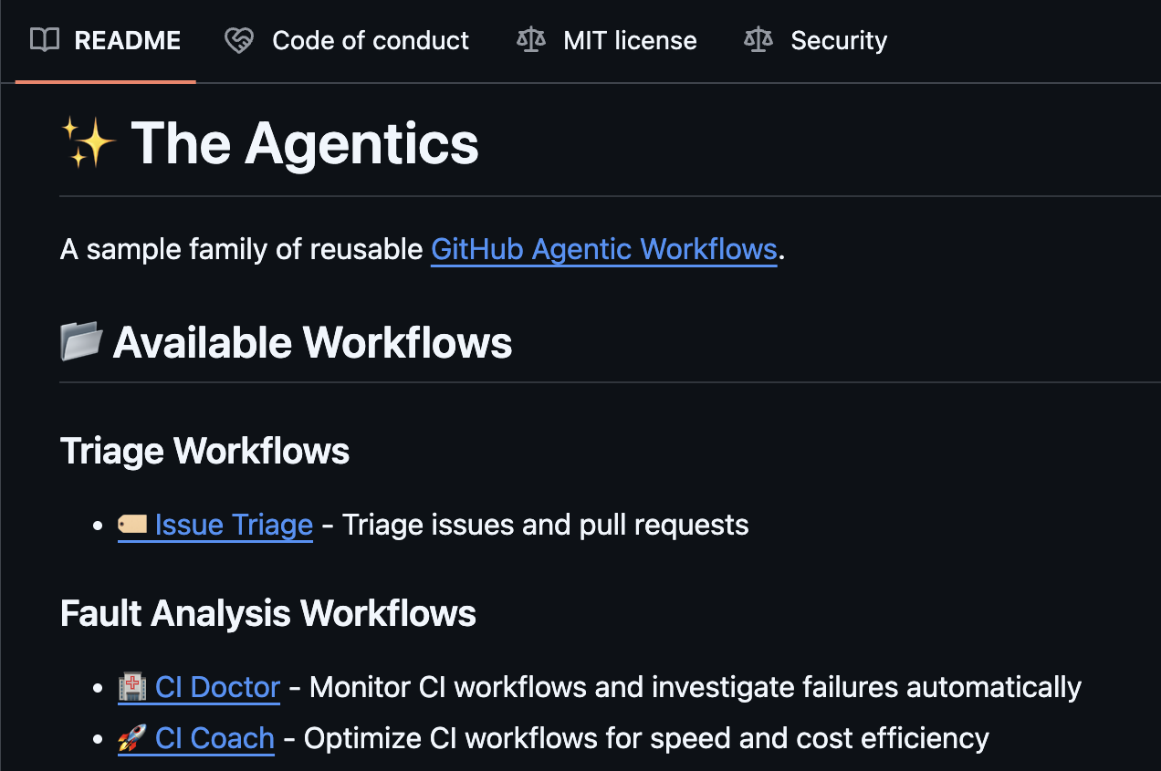
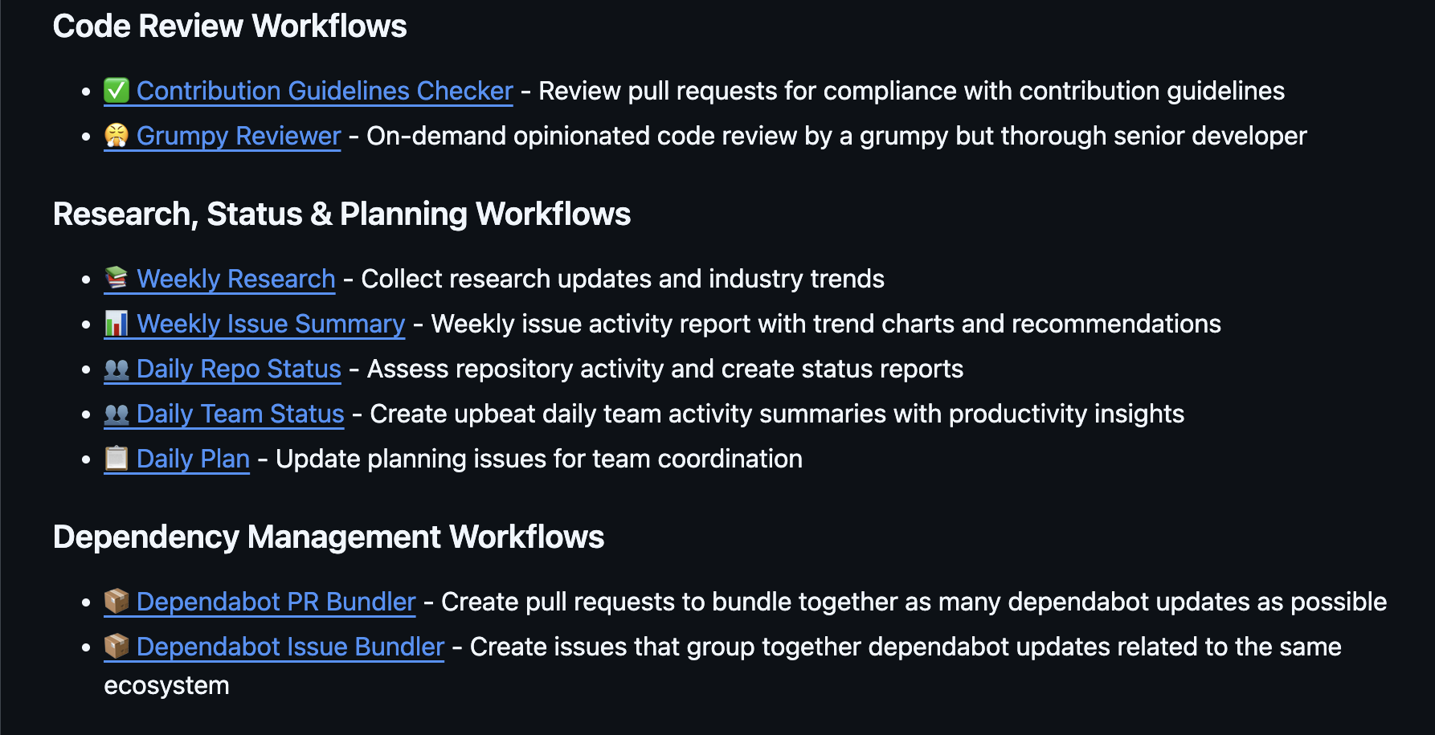
TECHNICAL PREVIEW
GitHub Agentic Workflows
Découvrez notre collection d'agents pour trouver l'inspiration.
Agentics
Notes:
If you’re looking for practical examples, explore our Agentics collection: This repository showcases real patterns and implementations of agentic workflows in action. It demonstrates how AI can be embedded into CI/CD to handle triage, automation, governance, and orchestration use cases.
Think of it as a design pattern library for Continuous AI. It provides inspiration, reference architectures, and concrete starting points you can adapt to your own repositories.
Rather than starting from scratch, you can explore proven approaches and see how agentic workflows are structured in real scenarios.
Speaking of real scenarios, let’s move onto the demos to see GitHub Agentic workflows in action!

Slide 12
Demo
Notes:
Demos:
(1) Installing our CLI and adding an Agentic Workflow (“Daily Repo Status”) to your repo from the Agentics collection.
(Like https://github.github.com/gh-aw/setup/quick-start/#adding-an-automated-daily-status-workflow-to-your-repo)
(2) Creating and editing Agentic Workflows directly from the web interface (via the agentic prompting experience).
(Like https://github.github.com/gh-aw/setup/creating-workflows/#github-web-interface)
(3) Real use case to meet enterprise demand: Rollout of an intelligent dependabot configuration across an entire org at scale.

Slide 13


GitHub Copilot Dev Days Sweepstake
Toutes les personnes ayant répondu au questionnaire participent automatiquement à notre tirage au sort pour gagner un abonnement d'un an à GitHub Copilot Pro+.
https://aka.ms/githubcopilotdevdays/sweepstakes

Slide 14
Thank you

